Slide 1

Risk Analysis
Name: Fahad Hussain
Roll no: 19SW136

Slide 2
Risks
Risks are potential problems that might affect the successful completion of a software project.
Risk Analysis are intended to help a software team to understand and manage uncertainty during the development process.

Slide 3
Strategies
There are 2 risk strategies:
Reactive Strategy
Proactive Strategy

Slide 4

Reactive Strategy
Software team does nothing until the risk becomes real.

Slide 5

Proactive Strategy
Risk management begins long before technical work start.
Risks are identified and prioritized by importance.
Then the team builds a plan to avoid risks if they can or minimize their probability of occurrence.

Slide 6
Categories Of Risks
There are 3 categories of risks:
Project Risk
Technical risk
Business Risk

Slide 7

Project Risk
Threatens the project plan.
If project risk becomes real, it is likely project schedule will slip and the costs will increase.
identifies problems related to budget, schedule and resources

Slide 8

Technical Risk
Threatens the Quality of the software to be produced.
Identifies problems related to design, implementation, maintenance.

Slide 9
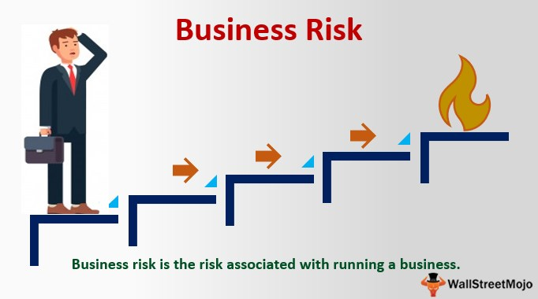
Business Risk
Threatens the viability( ability to work successfully)of the software to be built.

Slide 10

Examples Of Business Risk
Building an excellent product that no one wants.
Building a product that no longer fits into the overall business strategy.
Building a product that the sales force do not know how to sell.
Losing Budget.

Slide 11
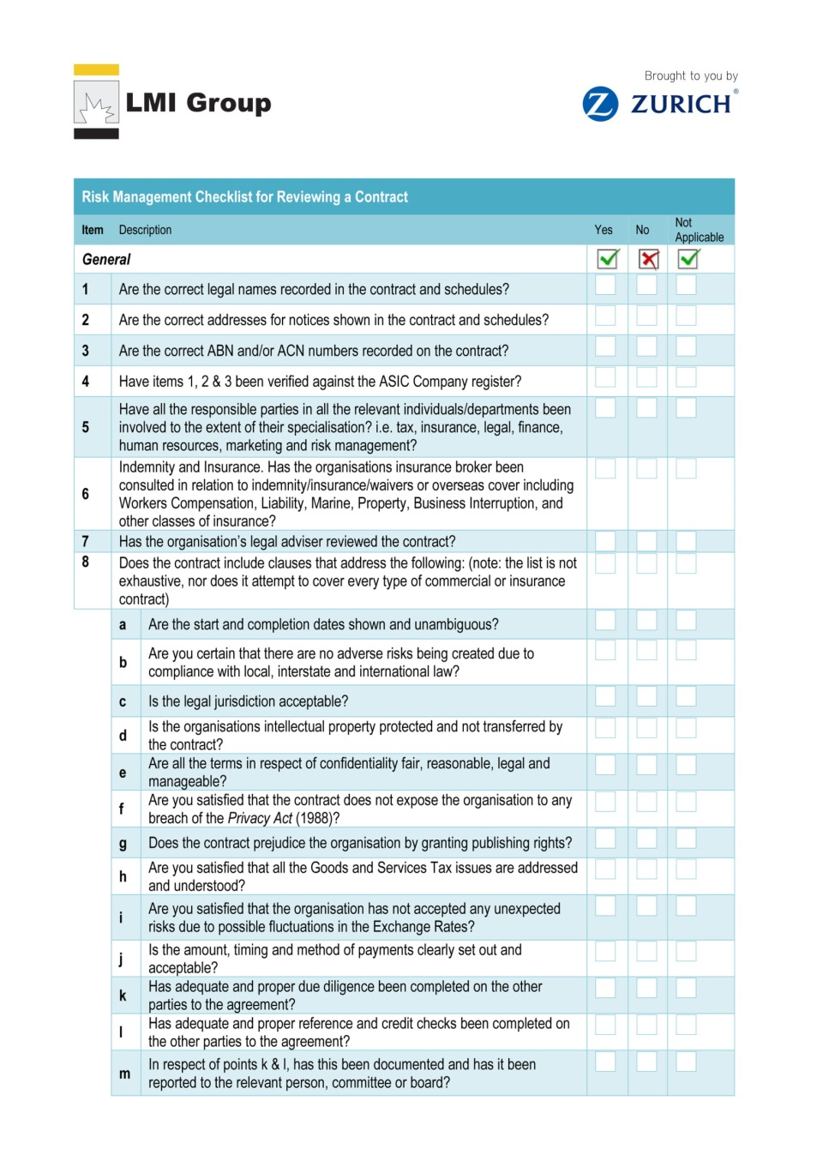
Risk Identification
List the risks associated with the project.
Use a risk item checklist to identify the risk ( Risk Item checklist is a set of questions relevant to each risk.)

Slide 12
Risk Projection
Risk projection is also called Risk Estimation.
Rates each risk in 2 ways:
Find the probability of occurrence of each risk.
Find the impact of the problems associated with each risk.

Slide 13
Steps For Risk Projection
Step 1: Prepare a risk table.
list all the risks identified in the first column.
category of the risk is identified in the second column:
PS- Project Size Risk
TE- Technical Risk
BU- Business Risk

Slide 14
Continue
Probability of occurrence is entered in the third column.
The Impact of each risk is assessed through the 4 Risk Components:
1. Performance:
If the risk becomes real will the requirements be met and will the product be fit for its intended use?

Slide 15
continue
2. Cost:
If the risk becomes real will the project budget be maintained?
3. Support:
If the risk becomes real will the resultant software be easy to correct?

Slide 16
continue
4. Schedule:
will the project schedule be maintained and the product will be delivered on time if the risk becomes real.

Slide 17
continue
The impact of each risk on the 4 components can be categorized as:
Catastrophic (involving or causing sudden great damage)
Critical (inclined to criticize severely and unfavorably)
Marginal (minor and not important)
Negligible (so small or unimportant as to be not worth considering insignificant)

Slide 18
